Slide 1
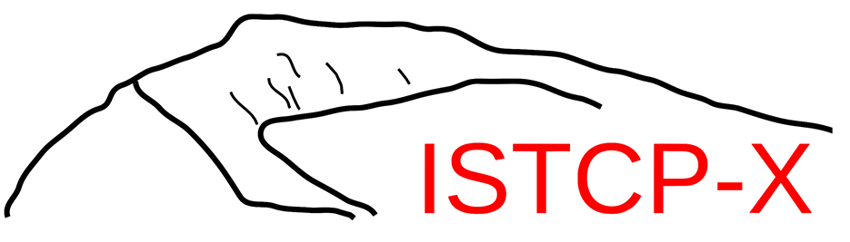




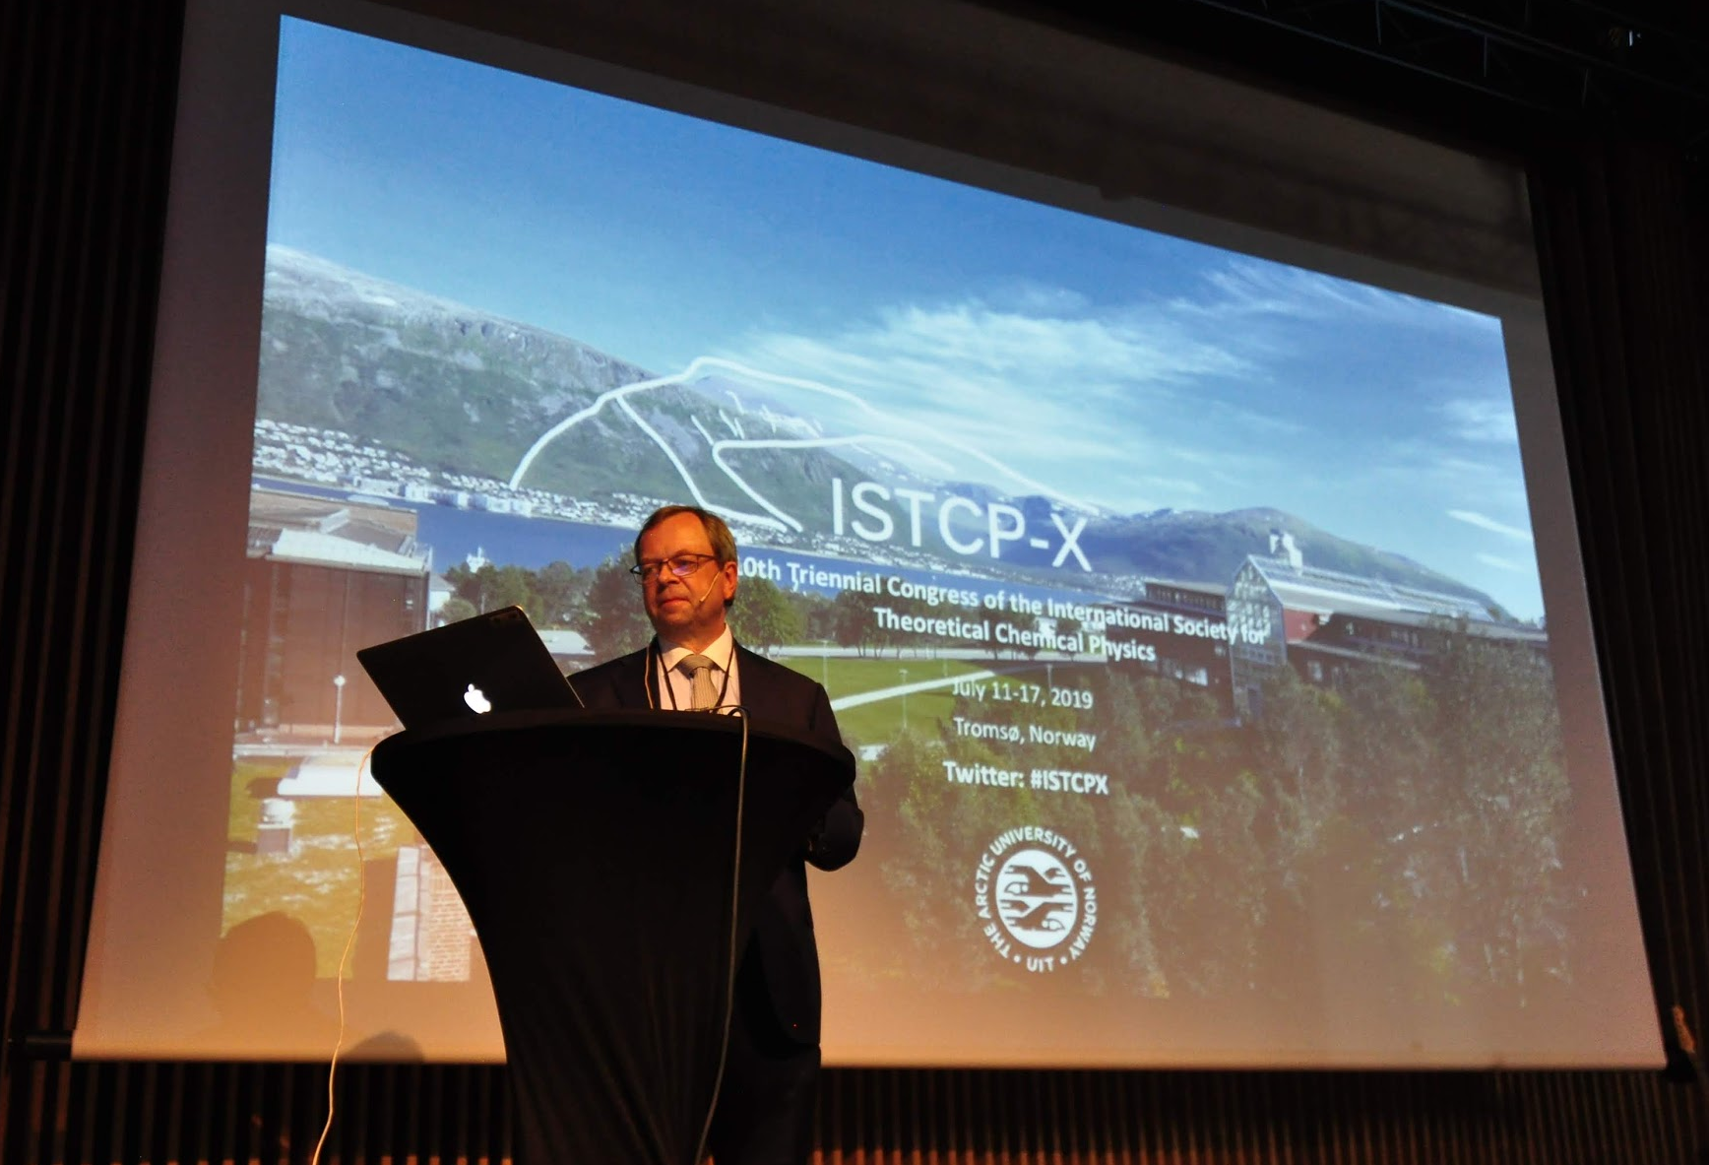
ISTCP-X debrief July 11-17, Tromsø, Norway
10th Triennial Congress of the International Society for Theoretical Chemical Physics
~35 hr journey
Several fjords
~150 speakers, ~550 attendees

Slide 2

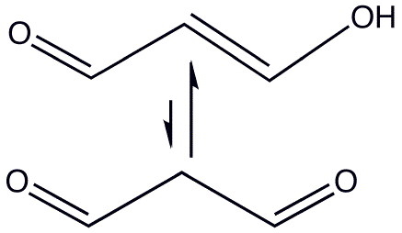


Propanedial and UV–x-ray pump-probe spectroscopy
N. H. List, A. L. Dempwolff, A. Dreuw, T. J. Martínez, P. Norman, In preparation.
Martínez Group
Nana List
In Silico proof-of-concept for experimental method to study photodecay processes
Collaboration with SLAC, proposing uses for new X-ray light sources.
UV pump prepares (𝝅,𝝅*) state. Decay to (n, 𝝅*). X-ray excites core into vacancy. Sensitive to chemical environment.
Studying intermolecular H-transfer, and conical intersection. (Think Norrish Type II)
They can’t access information on photoproducts and photodissociation dynamics.

Slide 3
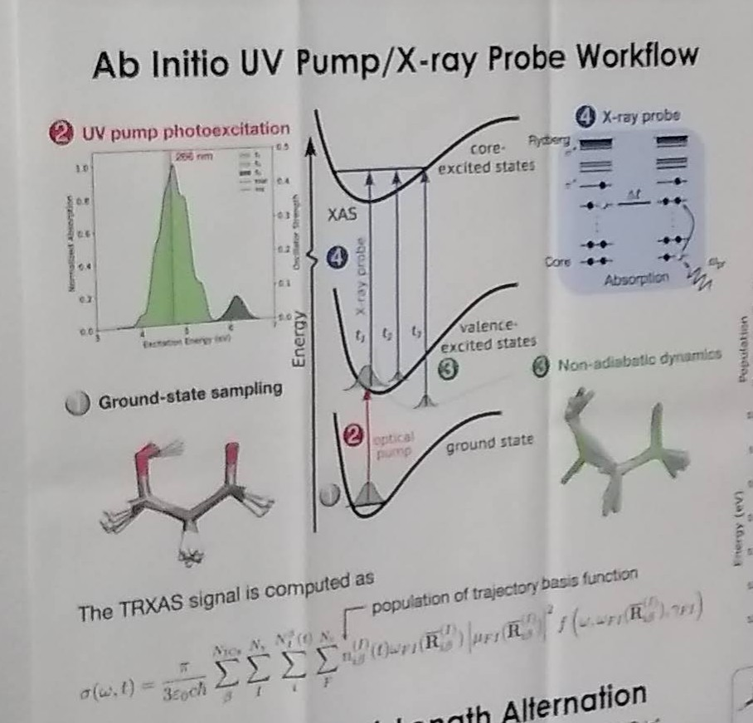
Proposed Technique
N. H. List, A. L. Dempwolff, A. Dreuw, T. J. Martínez, P. Norman, In preparation.
L. Young, et al., J. Phys. B.: At. Mol. Opt. Phys., 2018, 51, 032003. [Section 2.2]
Martínez Group
Apologies for the phone photo - unpublished work
In silico workflow designed to match forthcoming experiments
Ground state sampling to sample different FC initial configurations
Pump with 266 nm UV→S2 (𝝅,𝝅*)
Propagate nonadiabatic dynamics by AIMS
X-ray probe excites core into different vacancies due to S2, S1, S0
Separation of atomic K-edge spectra clear, several eV difference
Can detect chemical environment, bond-length alteration, etc.
Enol peak particularly sensitive to bond-length alternation

Slide 4
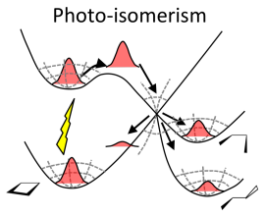
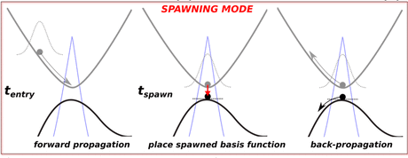
Ultrafast excited state dynamics - AIMS
B. F. E. Curchod, T. J. Martínez, Chem. Rev., 2018, 118, 3305-3336.
M. Ben-Nun, J. Quenneville, T. J. Martínez, JPCA, 2000, 104, 5161-5175.
Martínez Group
Need to couple both electronic and nuclear wavefunction dynamics
Nuclear wavefunction: linear combinations of gaussians with time-dependent coeffs.
1D gaussian basis function for each nuclear d.o.f. TD: R, P, Ɣ non-TD: gaussian width
Need to adaptively expand the nuclear basis set to account for QM phenomena
Expand only when classical dynamics fail - spawn (FC) when ￪ nonadiabatic couplings
AIMS - Ab Initio Multiple Spawning

Slide 5

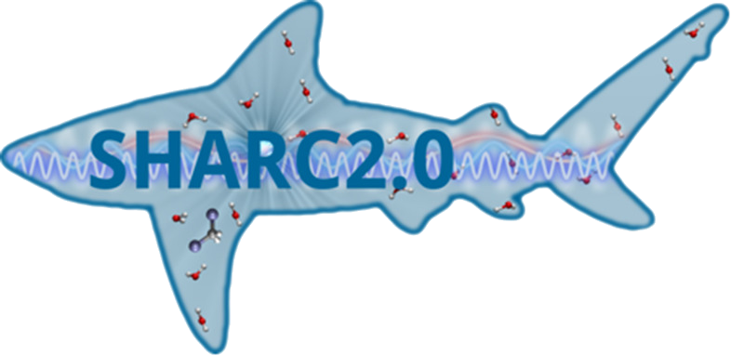

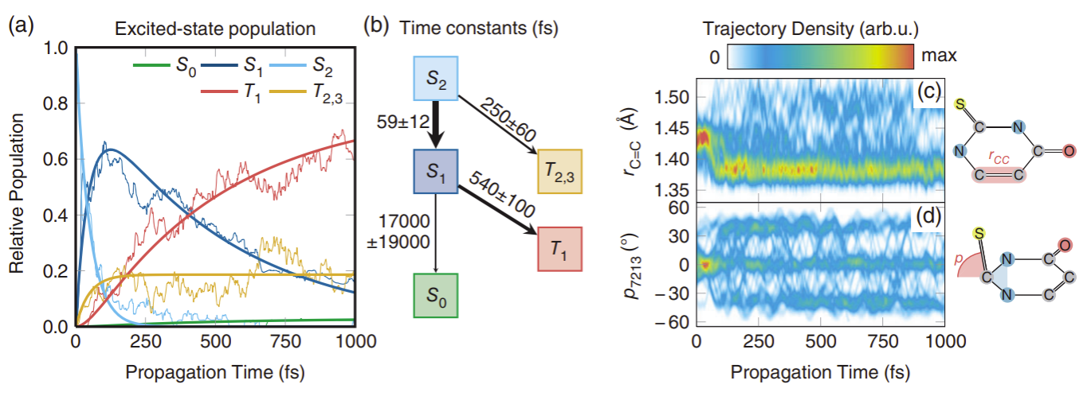
SHARC - Surface Hopping including ARbitrary Couplings
S. Mai, P. Marquetand, L. González, WIRES Comp. Mol. Sci, 2018, 8, 1370.
González Group
https://sharc-md.org
“Mr. SHARC”
Sebastian Mai

Slide 6
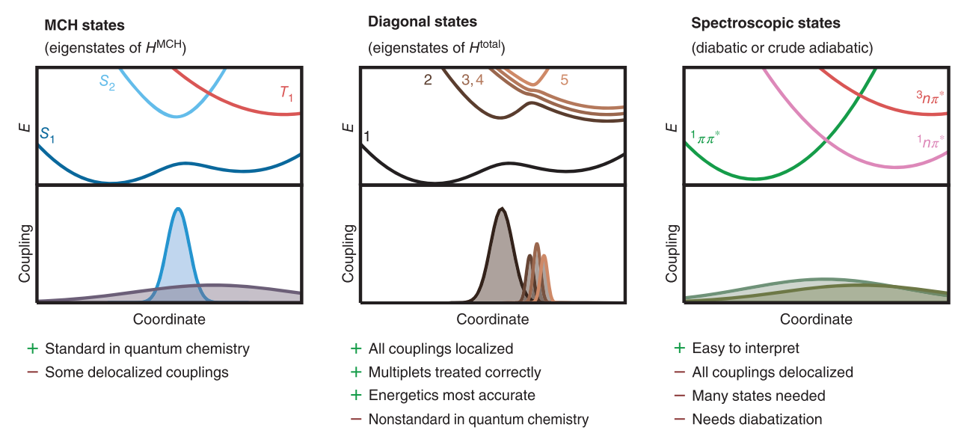
SHARC - Nonadiabatic, also spin-orbit, dipole, couplings
S. Mai, P. Marquetand, L. González, WIRES Comp. Mol. Sci, 2018, 8, 1370.
González Group
Misses quantum effects (ZPE, tunneling), but so does AIMS in a small nuclear basis
“Least switching” - switch stochastically only when the population of electronic state decreases
Electronic structure ‘on-the-fly’ - can even use QM/MM
Shortcomings: lacks decoherence, needs ensembles (stochastic), velocity scaling upon hops, EST wavefunction sign

Slide 7
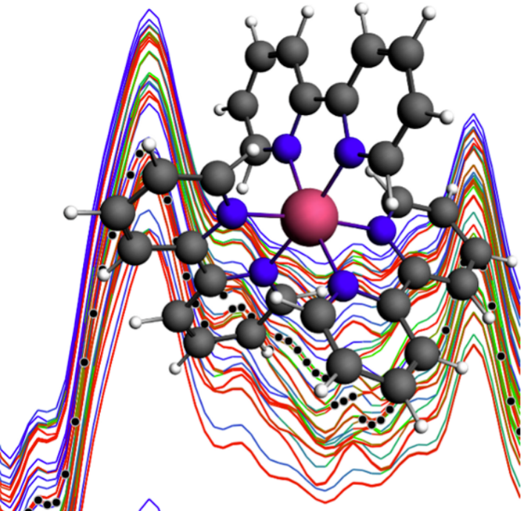
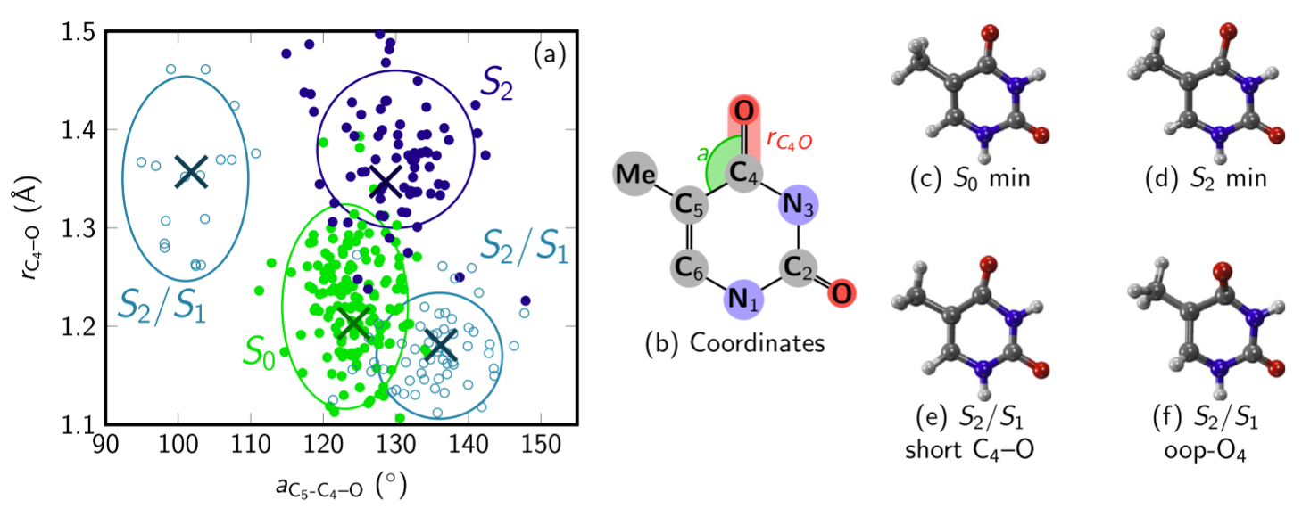
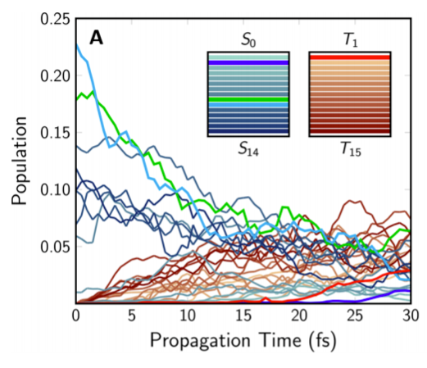
SHARC - Example applications
González Group
Organometallics
DNA bases
Interfaces: MOLPRO, MOLCAS, TURBOMOLE, COLUMBUS, ADF, GAUSSIAN, ORCA

Slide 8
Other interesting talks
Eric Neuscamman - Varionational excited states in electronic structure theory
Peter Gil - MP2 correlation energies by quadrature methods
Todd Martinez - Nonadiabatic dynamics of photoactive proteins using GPUs
Denis Jacquemin - Searching for super-accuracy in excited state calculations
Stefan Grimme - New tight-binding quantum chemistry methods
Satoshi Maeda - Automatic reaction path networks by Artificial Force Induced Reaction method
Heather Kulik - Transition metal catalysts through high-throughput and mechanine learning tools
Julien Blonio - A ‘virtual spectrometer’ to predict and interpret vibration spectra
David Clary - Semiclassical transition state theory (SCTST) and nerve agents
Morgane Vacher - Chemiluminescence of 1,2-dioxetane from MD and machine learning
Cristina Puzzarini - Rotational spectroscopy and quantum chemistry for astrochemistry (glycolaldehyde)

Slide 9

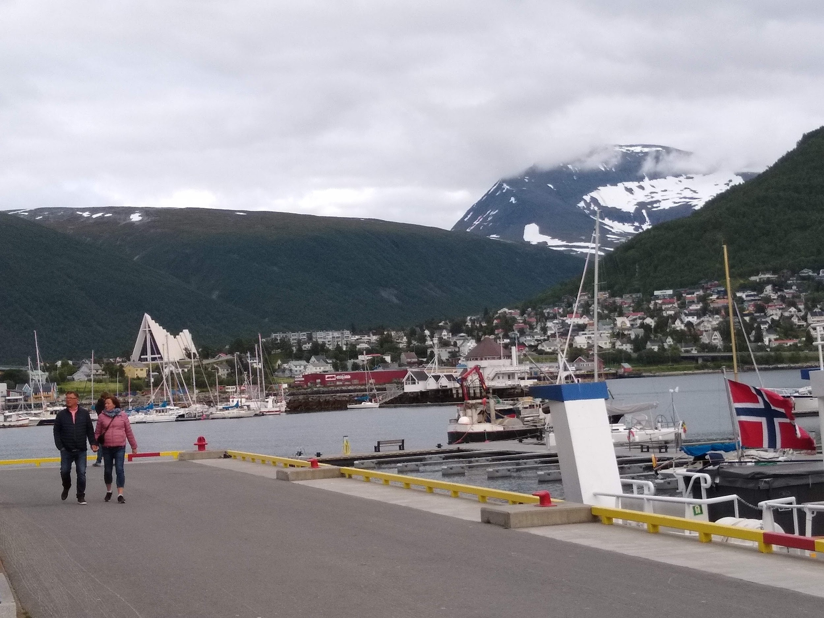
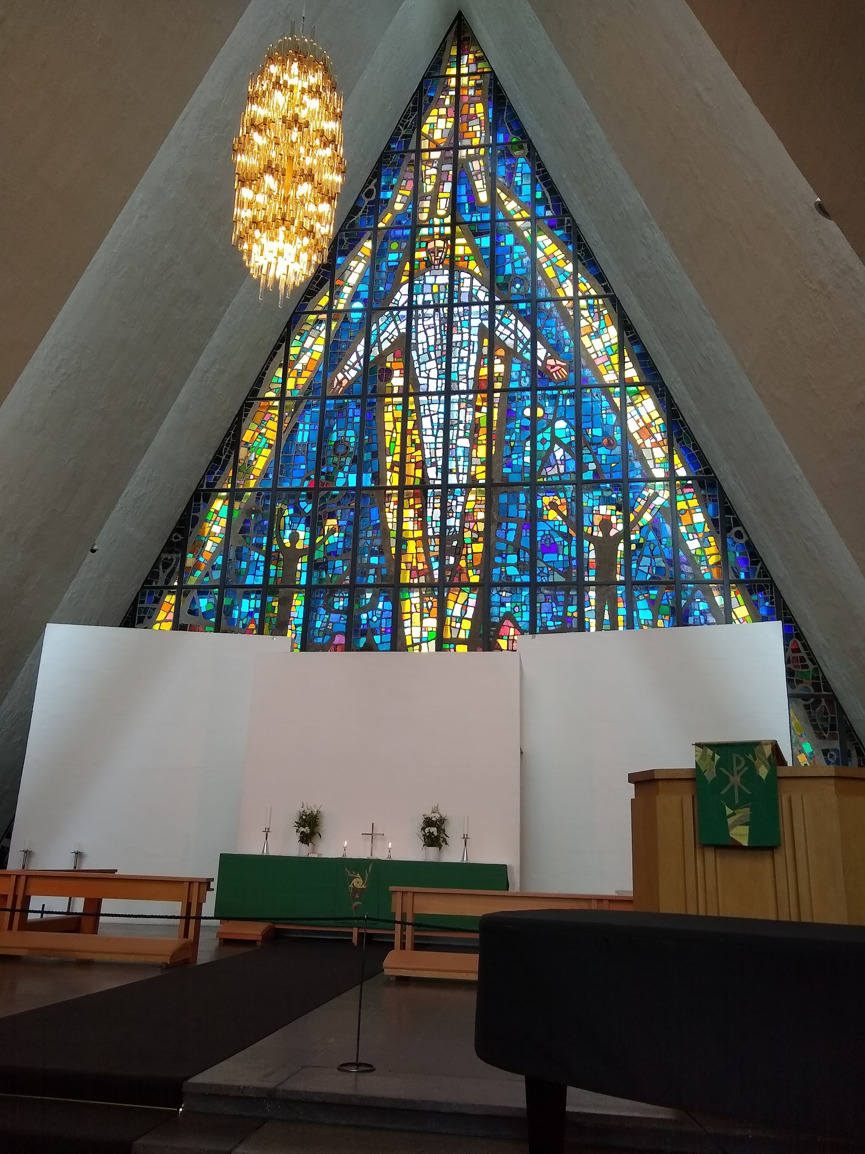

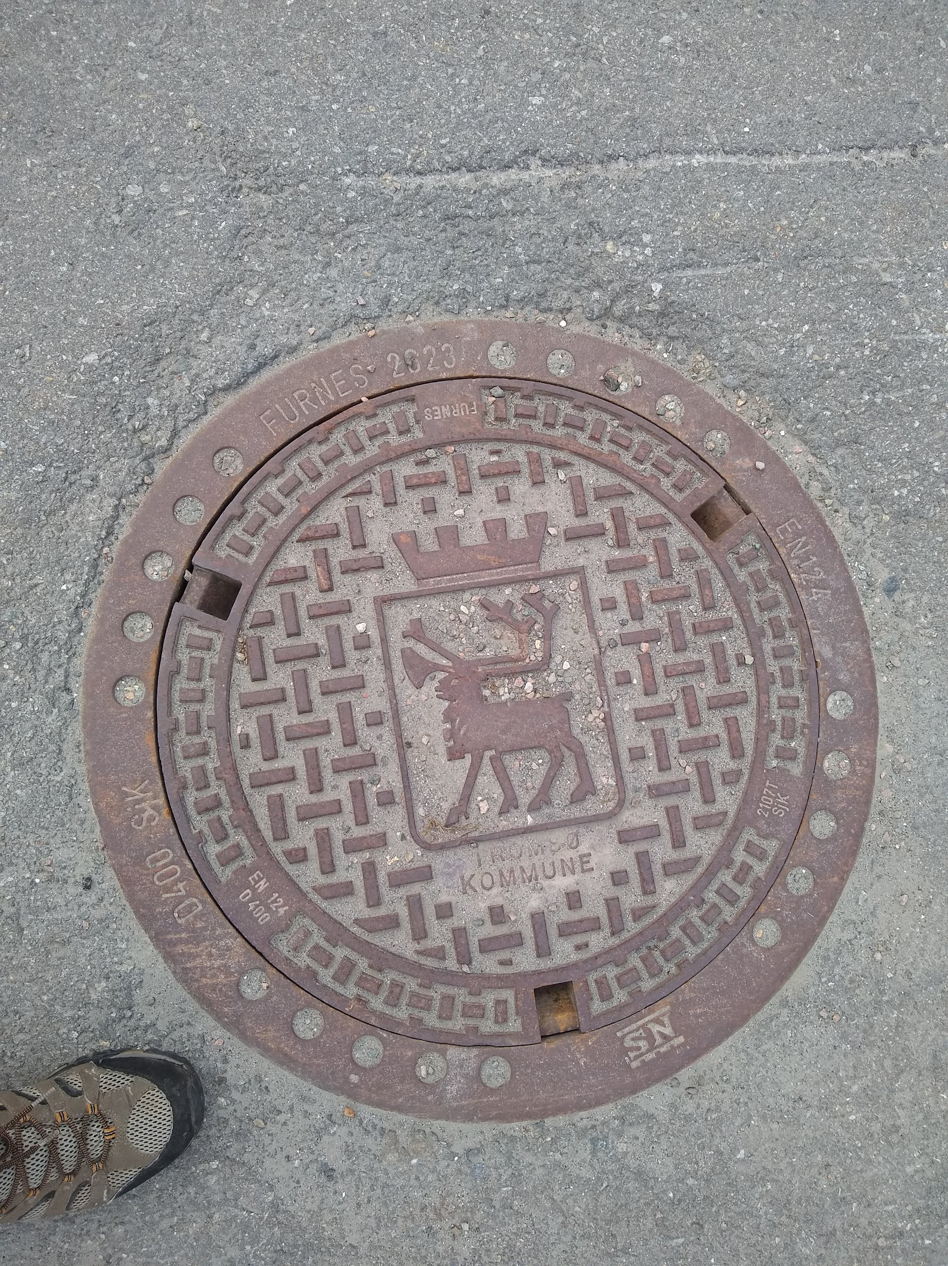

Thank you!

